Slide 1
Efficient Acceleration of Deep Learning Inference on Resource-Constrained Edge Devices
PHN-319
Technical Communication
Garvit
Notes:
With the rise of real-time applications like autonomous vehicles and IoT devices, Edge AI has become essential. However, deploying deep learning models on resource-constrained edge devices poses challenges due to limited processing power, memory, and energy. This report explores efficient techniques to accelerate deep learning inference on these devices, aiming to balance performance and resource usage. The findings have significant implications for enabling responsive and cost-effective AI in various applications.
Garvit PHN-319: Technical Communication

Slide 2
Introduction to Edge-AI
Edge AI enables AI models to run directly on devices (e.g., IoT sensors, smartphones) near the data source, reducing cloud dependency and enabling real-time decision-making.
Advantages –
Real-Time Processing: Instant responses without cloud delays (e.g., autonomous vehicles).
Enhanced Privacy: Local processing minimizes data exposure.
Reduced Bandwidth & Energy Use: Lower data transfer reduces costs.
Reliability: Works independently, even with limited connectivity.
For Example: Smart home devices (Alexa, Google Home) respond faster by processing audio locally.
Notes:
Low Latency and Real-Time Processing: Edge inference allows data to be processed locally without needing to be sent to a remote server. This reduces latency, enabling real-time or near-real-time processing. This is crucial for applications like autonomous vehicles, real-time healthcare monitoring, and industrial automation, where immediate responses are required.
Improved Data Privacy and Security: By processing data locally, Edge AI reduces the need to send sensitive information to the cloud, decreasing the risk of data breaches and enhancing privacy. This is beneficial in fields like healthcare and finance, where data privacy is paramount.
Reduced Bandwidth and Lower Costs: Edge inference reduces the amount of data that needs to be transmitted to the cloud, saving on bandwidth and associated costs. This is particularly important for IoT applications where constant cloud communication can lead to high data usage and expenses.
Greater Resilience and Reliability: Edge devices can continue functioning even with intermittent or no internet connectivity, making Edge AI suitable for applications in remote or challenging environments where reliable connectivity is not guaranteed.

Slide 3
Challenges of Edge Inference
Resource Constraints
Limited processing power and memory restrict model complexity.
Energy Efficiency
Battery-operated devices need low power consumption. Overheating can also be an issue.
Latency and Real-Time Processing
Applications require fast, real-time responses, often within milliseconds.
Privacy and Security
Sensitive data processed on-device requires strong privacy and security measures. For Example : - Wearables like fitness trackers need low-power AI models to function all day on small batteries.

Slide 4
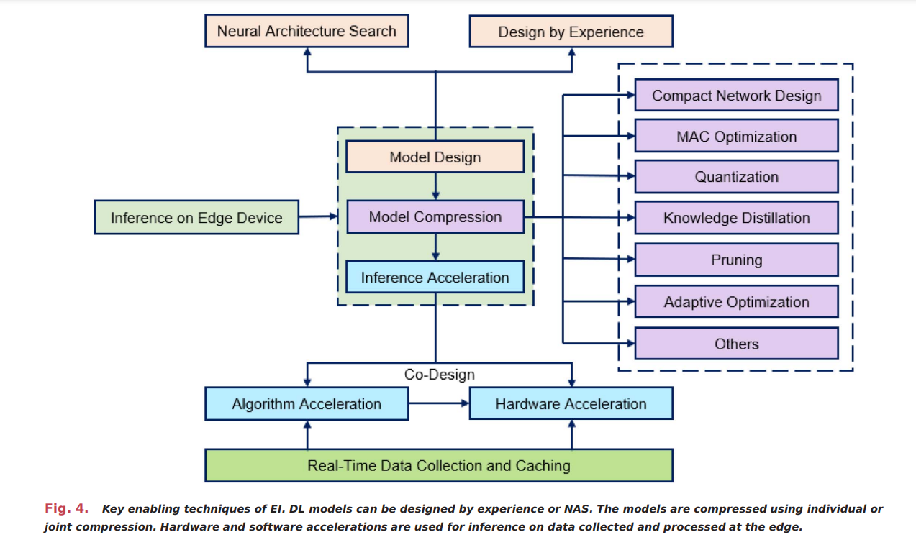
Types of Edge Inference Models
Cloud-Based Inference: Data sent to the cloud, processed remotely (e.g., Google Photos).
Edge-Based Inference: Processing is done fully on the device (e.g., image recognition on mobile devices).
Collaborative Inference: Combines edge and cloud processing for complex tasks (e.g., video processing split between camera and cloud server).

Slide 5
DEEP LEARNING METHODS
The neurons in NN map the inputs into activations for the next layer. The activations obtained by the multiplyand-accumulate (MAC) operations are fed as the input to the next layer and sequentially pass through the network architecture to generate the results.
Training Types
Supervised: Uses labelled data for classification tasks.
Unsupervised: Finds patterns without labels (e.g., clustering).
Reinforcement Learning: Learns by trial and error, maximizing rewards.
DL Model Types
FNNs: Basic, one-way information flow, ideal for classification.
CNNs: Extracts spatial features for image processing.
RNNs: Remembers sequence data (e.g., text or time series).
Core Components
Convolutions & Pooling: Feature extraction & down sampling in CNNs.
Activation Functions: ReLU, sigmoid add non-linearity.
Dropout: Reduces overfitting by randomly omitting neurons.
Applications
Image & Speech Processing: Object detection, face recognition, NLP.
Autonomous Systems: Self-driving cars, robotics.

Slide 6
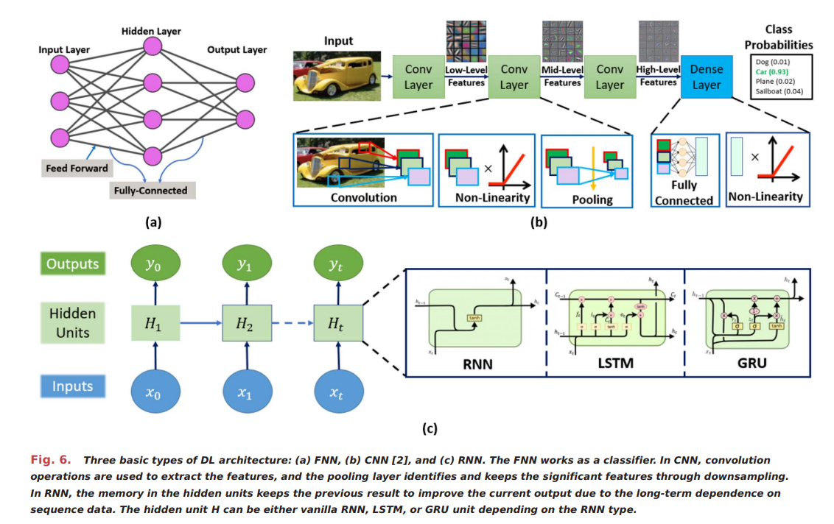
Three basic types of DL architecture
Notes:
Fully Connected Neural Network (FNN): In (a), all neurons are connected, and it's typically used for tasks like classification.
Convolutional Neural Network (CNN): In (b), CNNs process images by extracting features through layers like convolution, non-linearity, and pooling, finally using a dense layer for classification.
Recurrent Neural Network (RNN): In (c), RNNs are designed for sequence data. Variants like LSTM and GRU help capture long-term dependencies by storing information across time steps.
These architectures are foundational in deep learning, each suited to different types of data and

Slide 7
Model Optimization Techniques
Compact models and efficient compression techniques are developed to meet the massive trends in DL migration from the cloud to the edge.
Model Compression: Reduces the model’s size, making it lighter for edge devices. For Example :- MobileNet is a compressed model designed for mobile devices.
Quantization: Converts weights from 32-bit floating points to lower-precision (8-bit or even 4-bit integers). For Example :- Reducing a model’s memory requirements while still achieving 90%+ accuracy.

Slide 8
Pruning Techniques
Overview: Pruning removes unnecessary weights or filters from deep learning (DL) models, reducing model size and inference time, ideal for resource-constrained edge devices.
Types of Pruning:
Unstructured Pruning: Eliminates individual weights with low importance but may lead to irregular computation, challenging for hardware.
Structured Pruning: Removes entire groups, such as filters, maintaining a regular structure, beneficial for hardware efficiency.
Methods:
Magnitude-Based: Prunes weights below a certain threshold, requiring careful tuning to balance accuracy and efficiency.
Regularization-Based: Adds constraints to the loss function for sparsity, but may require extensive training iterations.
Energy-Aware: Focuses on energy-efficient pruning by estimating each weight’s energy consumption.
Benefits: Reduces memory usage, computation, and power consumption while retaining model performance within acceptable bounds for edge deployment.

Slide 9
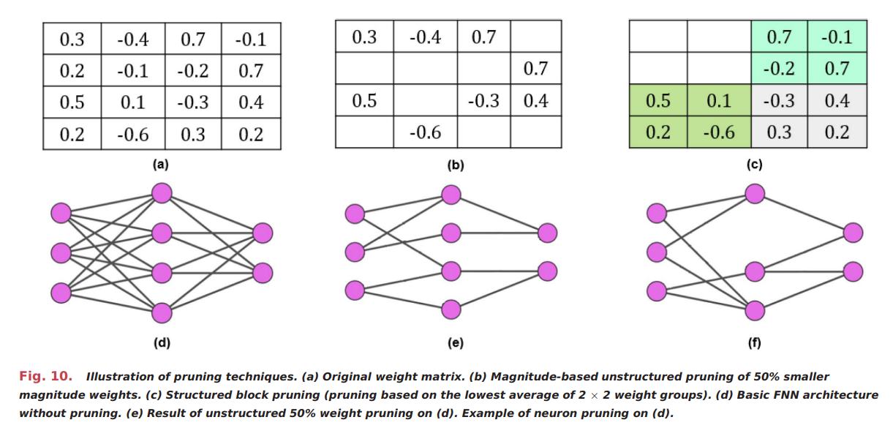
Illustration of Pruning Techniques
Notes:
Original Matrix (a): All connections are intact.
Unstructured Pruning (b): Removes 50% of the smallest weights, making the network sparse by setting these weights to zero.
Structured Block Pruning (c): Prunes weights in 2x2 blocks based on average values, retaining some structure for easier hardware optimization.
In the diagrams below:
(d) is the fully connected network.
(e) shows the network after unstructured pruning.
(f) shows the network after structured pruning.
These methods help reduce model size and computational load without significant accuracy loss.

Slide 10
Quantization
Overview: Quantization reduces the precision of weights and activations (e.g., from 32-bit to 8-bit or binary), allowing faster computations, lower memory usage, and enhanced energy efficiency on edge devices.
Types of Quantization:
Linear Quantization: Maps floating-point values to fixed-point numbers with equal step sizes, suitable for standard DL models.
Nonlinear Quantization: Uses logarithmic or custom scales for better accuracy in complex models with varied data distributions.
Methods:
Fixed-Precision Quantization: Applies a consistent bit-width (e.g., 8-bit) across all layers, balancing simplicity and efficiency.
Mixed-Precision Quantization: Allows varied bit-widths across layers, optimizing memory and performance based on layer importance.
Binarization: Uses 1-bit (binary) or 2-bit (ternary) values, significantly reducing computations but challenging for maintaining model accuracy.
Benefits: Enables efficient integer operations, speeds up inference, reduces energy consumption, and helps deploy DL models on resource-constrained devices without significant accuracy loss.
Notes:
Overview: Quantization reduces precision (e.g., from 32-bit to 8-bit) for faster computations, lower memory use, and better energy efficiency on edge devices.Types:Linear: Maps values with equal steps, common for deep learning models.
Nonlinear: Uses custom scales for accuracy in complex data.
Methods:Fixed-Precision: Uniform bit-width across layers.
Mixed-Precision: Varies bit-width by layer for optimal memory and performance.
Binarization: Uses 1-bit or 2-bit values for minimal computation.

Slide 11
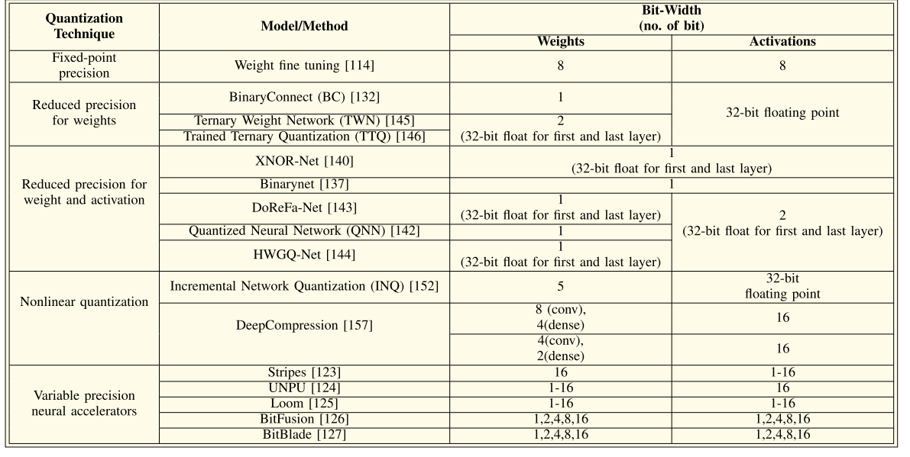
Summary of Noteworthy Works on the Quantization of DL Models

Slide 12
Neural Architecture Search (NAS)
Overview: NAS `, optimizing model performance while meeting hardware constraints, making it ideal for edge devices.
Components of NAS:
Search Space: Defines the range of possible architectures, constrained to keep the process manageable (e.g., specific layers, operations, or patterns).
Search Strategy: Guides exploration within the search space, often using reinforcement learning or evolutionary algorithms.
Performance Estimation: Assesses model accuracy and efficiency on the target hardware, helping select optimal architectures without full retraining.
Popular NAS Techniques:
MobileNet-v3: Uses NAS and NetAdapt to design lightweight models, achieving improved speed and accuracy for mobile platforms.
MNASNet: Optimizes mobile architectures by balancing accuracy and latency, achieving faster inference than other models like MobileNet.
Benefits: NAS reduces manual effort, finds efficient architectures tailored to specific hardware, and achieves high-performance models for resource-constrained environments.

Slide 13
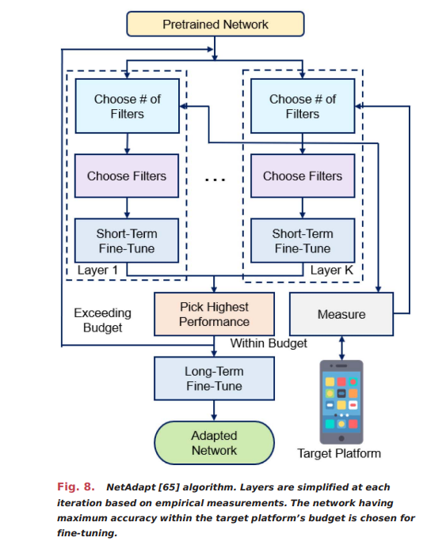
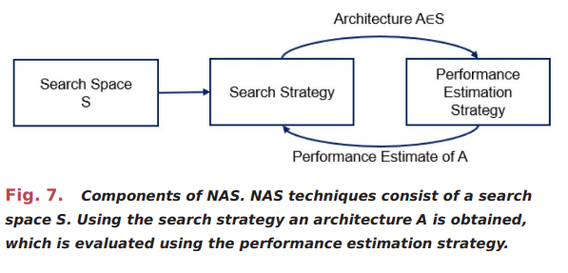
Notes:
Fig. 7 (NAS Components): Neural Architecture Search (NAS) is a framework that helps automatically design neural network architectures. It involves three main components:
Search Space (S): Defines the possible architectures to explore.
Search Strategy: Guides the exploration of architectures within the search space to find an optimal model.
Performance Estimation Strategy: Evaluates each chosen architecture's performance, feeding this back to the search strategy for iterative improvement.
Fig. 8 (NetAdapt Algorithm): NetAdapt is a method that optimizes a pretrained network to fit resource constraints on a target platform (like a mobile device).
The algorithm adjusts the network layer-by-layer by selecting the number of filters and performing short-term fine-tuning.
It iteratively checks if each modification meets budget constraints (like memory or computational limits).
Once all layers are adapted within the budget, a long-term fine-tuning step produces the final optimized network, ready for deployment on the target platform.

Slide 14
Joint Compression Techniques
Overview: Joint compression techniques combine multiple model compression methods to improve efficiency, balancing storage and computational demands, which is essential for edge devices with limited resources.
Common Approaches:
Pruning + Quantization: This approach first removes unimportant weights (pruning) to reduce computation, then applies quantization to lower precision, significantly reducing storage requirements while retraining to maintain accuracy. For example, combined pruning and quantization on RNN models can lead to 10× and 2× speedups, respectively​.
Weight Sharing + Huffman Coding: Grouped weight values are shared across the model using clustering techniques like k-means. Huffman coding is applied afterward to further compress the weights, achieving high memory savings without major impact on computational accuracy​.
Benefits: Joint compression techniques achieve a balance of minimal accuracy loss and high compression efficiency, making deep learning models feasible for deployment on resource-constrained devices.

Slide 15
Hardware Optimization for Edge-AI
Overview: Hardware optimization in Edge-AI focuses on adapting devices to meet deep learning (DL) inference requirements under constraints like limited memory, computation power, and energy on edge devices, essential for real-time applications.
Hardware Choices:
ASICs (Application-Specific Integrated Circuits): Customized for specific DL models, offering high efficiency but lacking flexibility. Examples include Google’s Edge TPU, optimized for high-speed, low-power AI processing.
FPGAs (Field-Programmable Gate Arrays): Reconfigurable hardware that supports diverse architectures, suitable for prototyping and moderate energy efficiency.
SoCs (System-on-Chip): Integrates CPUs, GPUs, and accelerators, offering a balanced approach for flexibility and efficiency.
Optimization Techniques:
Parallelism: Uses multiple cores or processing units to improve throughput, essential for faster inference.
Memory Management: Optimizes data transfer and storage within hardware, reducing bottlenecks and power usage.
Dataflow Optimization: Reduces latency by improving how data is processed and transferred within the hardware components.
Benefits: Enables edge devices to handle complex DL models with reduced latency, lower power consumption, and increased efficiency, critical for applications like autonomous driving, healthcare, and IoT.
Notes:
Purpose:
Adapting hardware to support AI tasks on compact devices, balancing speed and efficiency for immediate use.
2. Key Hardware Types:
Custom Chips: Highly efficient, built for specific AI tasks but with limited adaptability.
Programmable Hardware: Flexible designs that can be adjusted for various AI applications, suitable for testing new approaches.
Integrated Systems: Combine processing units in one setup to offer a versatile solution with efficient performance.
3. Optimization Methods:
Parallel Processing: Uses several cores simultaneously to boost processing speed.
Efficient Data Handling: Streamlines data movement to avoid slowdowns and conserve power.
Streamlined Data Flow: Minimizes waiting times by ensuring smooth data transitions within the system.
4. Advantages:
Makes it possible to run advanced AI on small devices, reducing power and cost—ideal for fields like self-driving cars, medical tech, and smart devices.

Slide 16
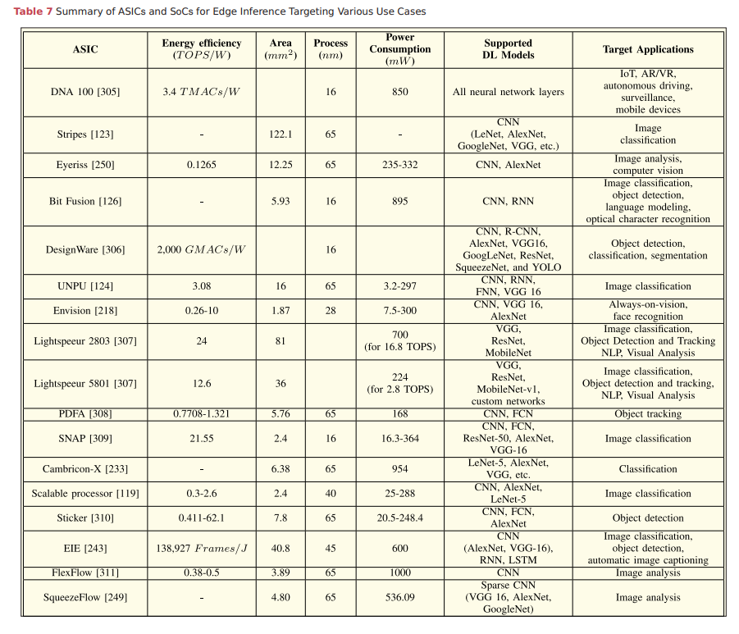
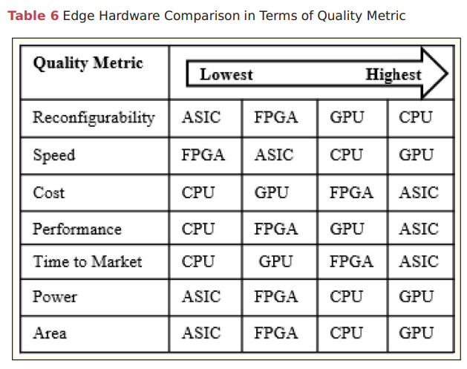
Notes:
Different hardware types have unique strengths. GPUs are highly adaptable, ideal for multiple tasks. ASICs deliver top speed and performance but lack flexibility, while FPGAs balance between the two."
"ASICs are cost-effective and compact, but CPUs and GPUs are faster to deploy. GPUs also excel in power efficiency, while ASICs may consume more power."
2. Hardware Examples & Applications:
"DNA 100 and Stripes are energy-efficient, suited for IoT and mobile AI tasks. DesignWare and Eyeriss handle complex image-based applications like object recognition."
"Some hardware, like SNAP and FlexFlow, focus on deep learning tasks like image classification, benefiting fields such as healthcare, automotive, and security."
3. Summary:
"Selecting the right hardware depends on the specific needs of the application—whether it’s speed, flexibility, or efficiency, each type has a role in edge-AI deployments."

Slide 17
Performance Metrics for Edge-AI
Model Size: Smaller models are favored for edge devices due to limited storage and memory constraints, directly influenced by network architecture and the number of parameters.
Accuracy and Robustness: Ensures that inference outputs meet task requirements. For critical applications like autonomous driving, accuracy is crucial, as is robustness to environmental changes.
Area and Cost: Refers to the silicon area (chip space) needed, affecting both production cost and power consumption.
Power Consumption: Expressed in milliwatts or microwatts, this metric includes the power required for memory access and computational tasks, essential for battery-operated devices.
Energy Efficiency: Measures the number of operations per watt, typically as giga or tera operations per watt (GOPS/W or TOPS/W), evaluating how well energy is utilized during inference.
Latency: Measures the time taken from input to output generation. Low latency is vital for real-time applications, like augmented reality (AR) or robotics.
Throughput: Indicates the number of inputs processed per unit time, often expressed in operations per second, and is crucial for high-demand applications requiring real-time results.
Memory Requirements: Important for optimizing memory access and reducing power usage, as edge devices typically have restricted memory​​​.
Notes:
Model Size: Smaller models suit edge devices with limited memory. Accuracy & Robustness: Key for reliable outputs in critical applications .Area & Cost: Affects production cost and power use. Power Consumption: Essential for battery-based devices. Energy Efficiency: Measures operations per watt for energy use .Latency: Important for real-time response. Throughput: Number of inputs processed per second. Memory Requirements: Optimizing memory is crucial for edge devices.

Slide 18
Challenges and Future Trends in Edge-AI
Challenges:
Balancing model size with accuracy.
Reducing energy consumption without sacrificing performance.
Future Trends:
Federated Learning: Training AI models directly on edge devices for enhanced privacy.
Mixed-Precision Computing: Using a mix of high and low precision for faster, more efficient inference.
Example: Federated learning on smartphones for personalized text predictions.

Slide 19
CONCLUSION
Summary: Edge-AI enables efficient processing of data on constrained devices by optimizing models and hardware.
Key Takeaway: Continuous innovations in model design, optimization, and hardware are essential for advancing edge-AI.
Final Example: Real-time image recognition in autonomous drones, relying on all aspects discussed to operate efficiently on-the-go.

Slide 20
Thank You !

